Slide 1
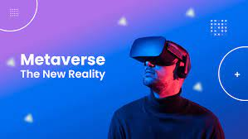
What is
METAVERSE?
A Brief History of The Future

Slide 2
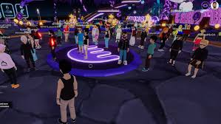
Metaverse ??
THE TERM “METAVERSE” WAS COINED BY AUTHOR Neal Stephenson in his 1992 novel Snow Crash.
Stephenson’s book provided no specific definition of the Metaverse, but what he described was a persistent virtual world that reached, interacted with, and affected nearly every part of human existence.

Slide 3
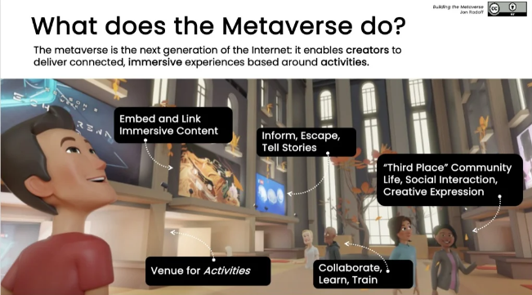

Slide 4
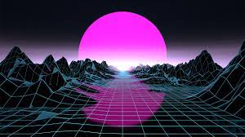
FUTURE OF METAVERSE
The Metaverse is not a future: It is already here, It is a conversation about becoming ,not simply being.

Slide 5
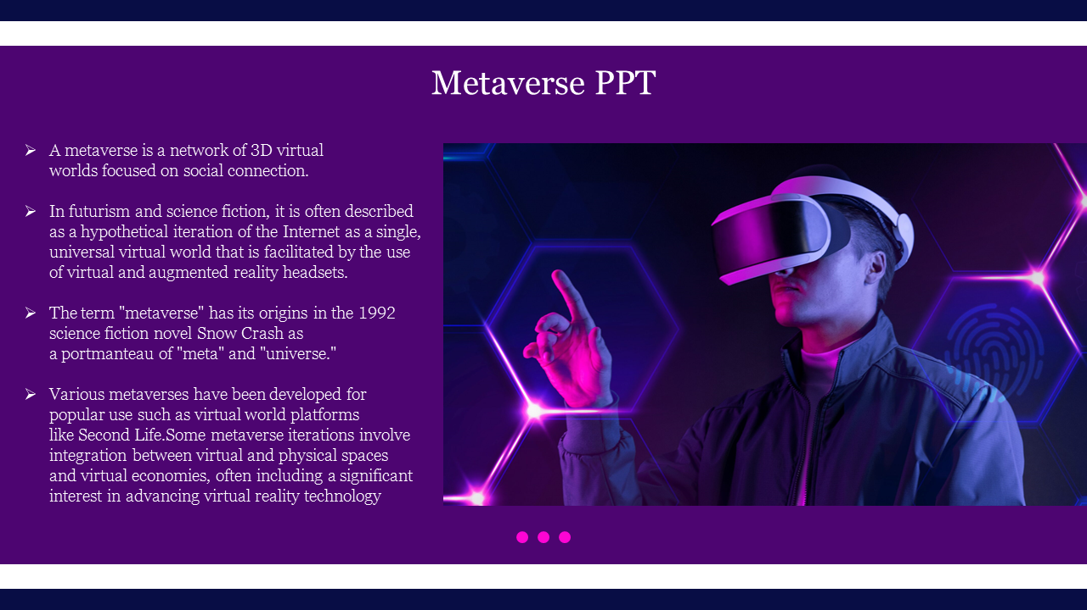

Slide 6
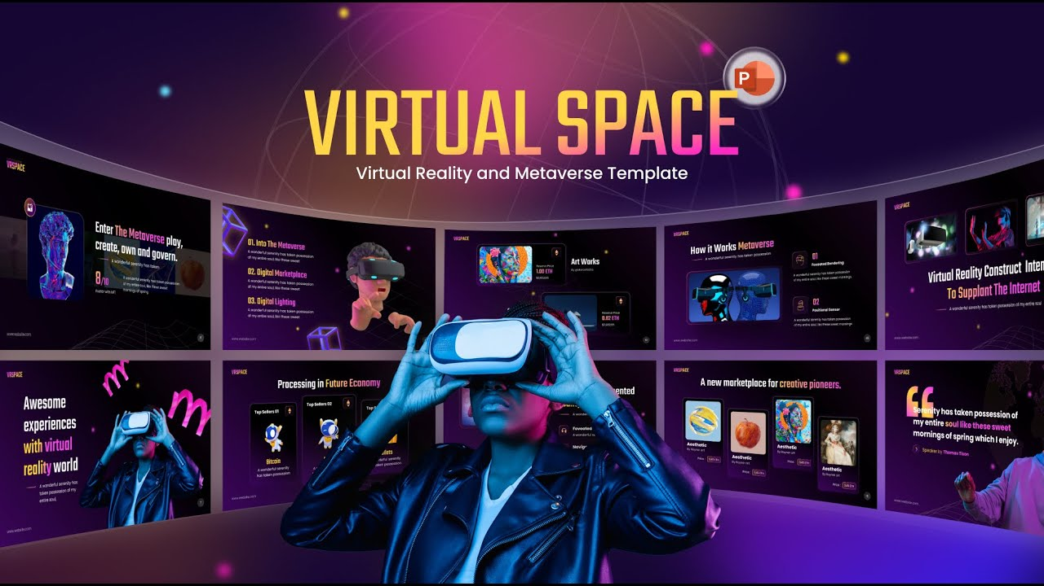
The metaverse is, in fact, a virtual realm in which users have the ability to create and modify the environment itself.

Slide 7
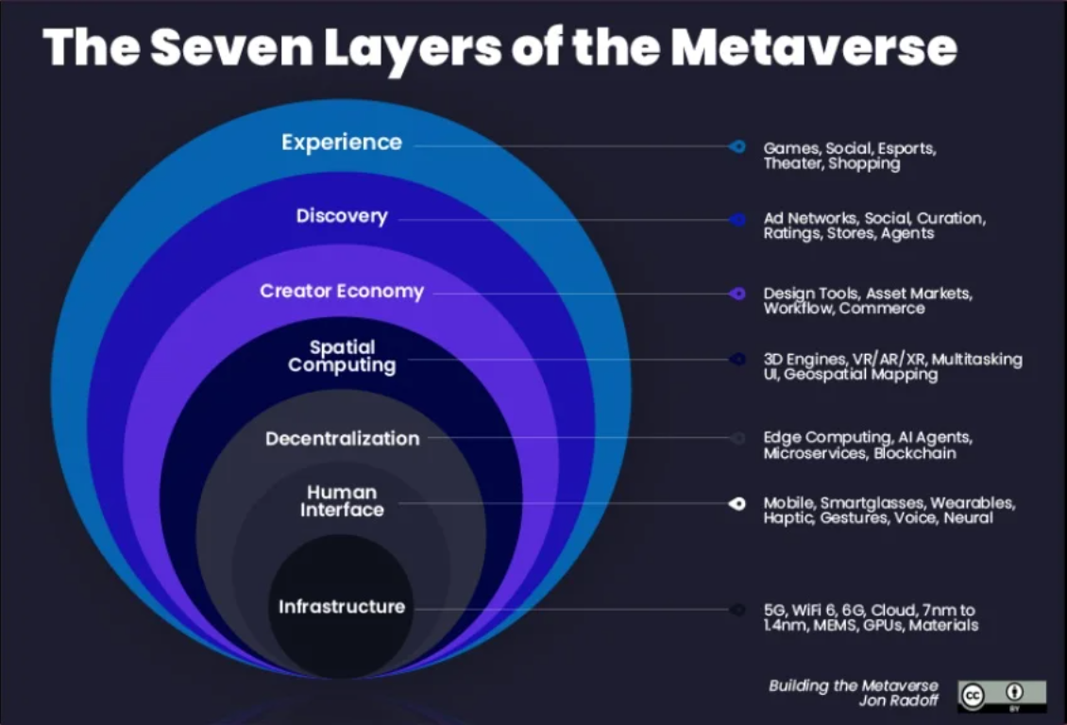

Slide 8
